Slide 1

CSE- 4105
Lecture- 12
Clipping-I

Slide 2
Clipping
Analytically calculating the portions of primitives within the viewport

Slide 3
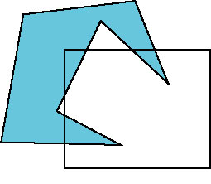
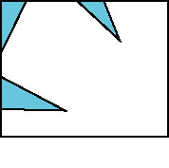
Clipping
An algorithm for 3D clipping identifies and saves all surface segments within the view volume for display.
All parts of object that are outside the view volume are discarded.

Slide 4
Coordinate Systems
y
v
(u,v)
(x, y)
0
x
0
u
World Coordinates:
User-Defined Limits
Floating point values
Device Coordinates:
Device dependent Limits
Positive Integer values
Notes:
‹#›

Slide 5
The Viewing Pipeline
Window
A world-coordinate area selected for display.
defines what is to be viewed
Viewport
An area on a display device to which a window is mapped.
defines where it is to be displayed
Viewing transformation
The mapping of a part of a world-coordinate scene to device coordinates.
A window could be a rectangle to have any orientation.

Slide 6
Window to Viewport
We denote the boundaries of the world window by four real values xmin, ymin, xmax, ymax
left, bottom, right, top margins respectively.
Similary the boundaries of the viewport on the screen are defined by four integer values umin, vmin, umax, vmax.
When a graphics display is generated using arbitrary coordinates on the world window, the important problem encountered in viewing this display on the actual viewport on the screen is to have a function which maps every point (x,y) on the window to a corresponding point (u,v) on the viewport.
The following window to viewport transformation achieves this relationship.

Slide 7


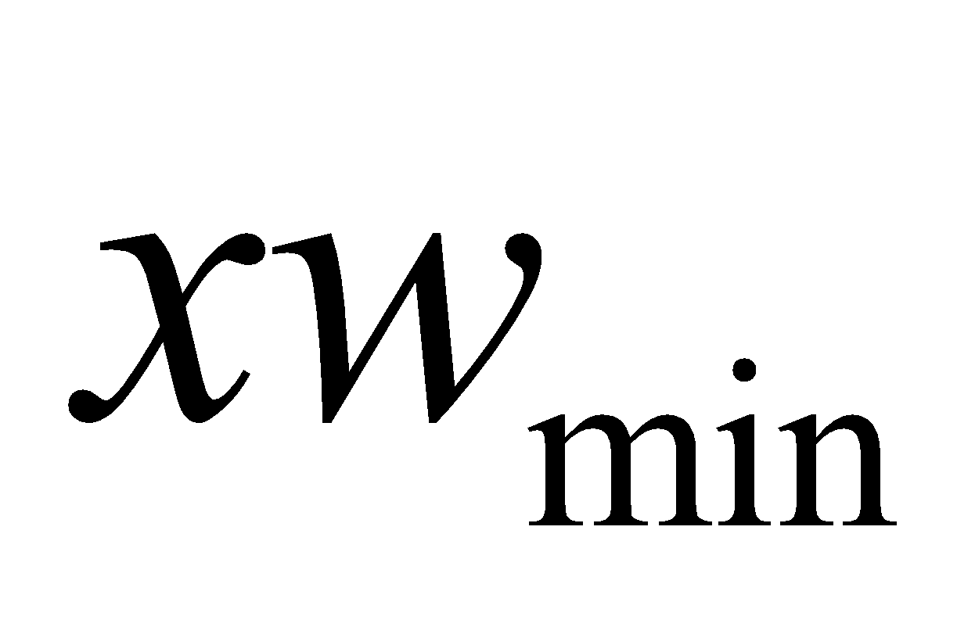


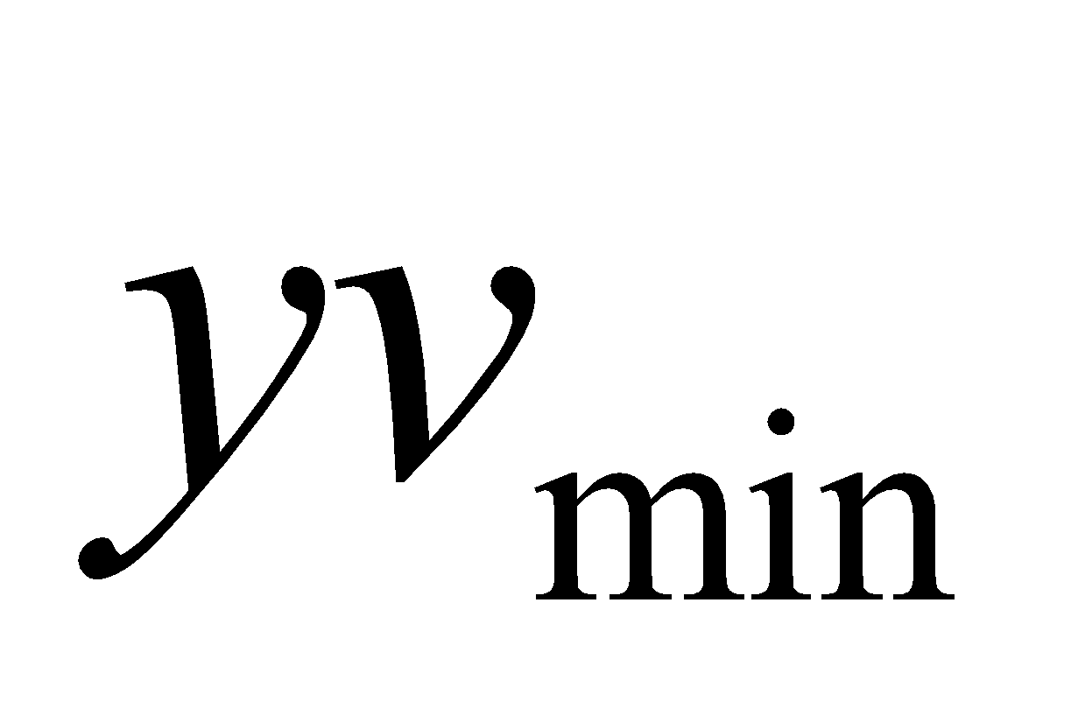
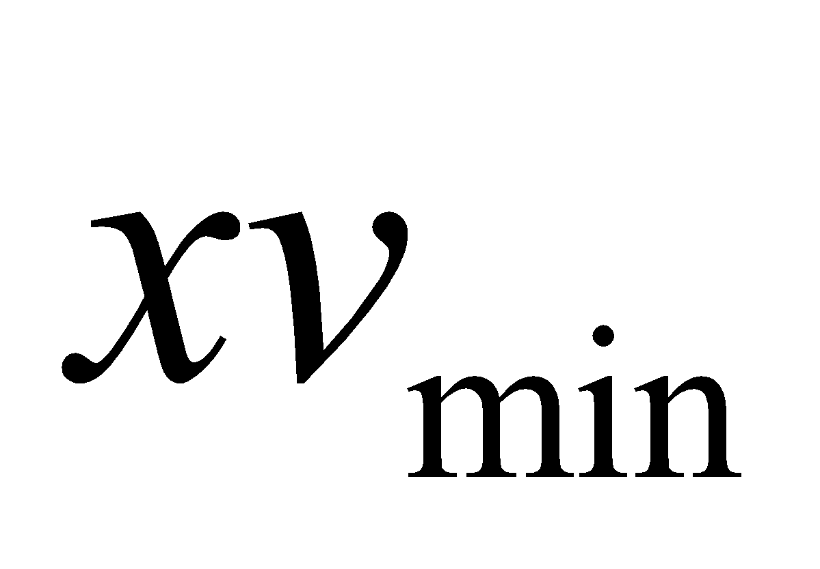
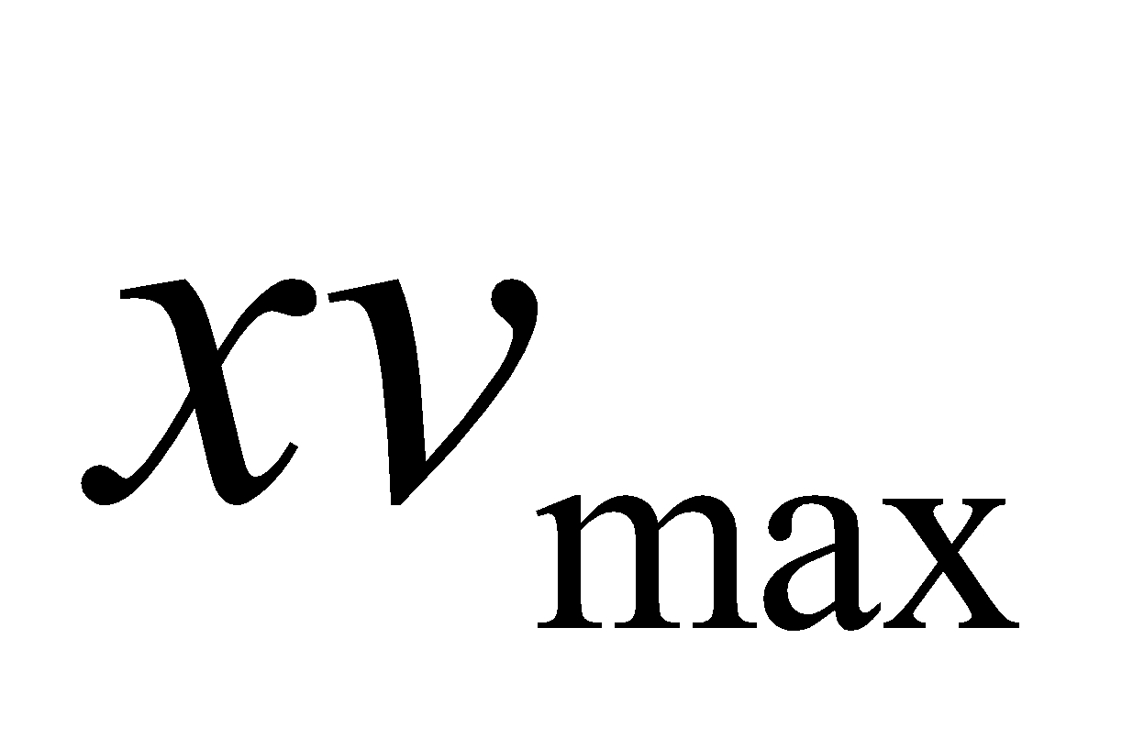
Window to Viewport
Clipping Window
World Coordinates
The clipping window is mapped into a viewport.
Viewport
Viewing world has its own coordinates, which may be a non-uniform scaling of world coordinates.
Viewport Coordinates

Slide 8
Clipping Operations
Clipping
Identify those portions of a picture that are either inside or outside of a specified region of space.
Clip window
The region against which an object is to be clipped.
The shape of clip window
Applications of clipping
World-coordinate clipping

Slide 9
Clipping Operations
Viewport clipping
It can reduce calculations by allowing concatenation of viewing and geometric transformation matrices.
Types of clipping
Point clipping
Line clipping
Area (Polygon) clipping
Curve clipping
Text clipping
Point clipping (Rectangular clip window)

Slide 10
Line Clipping
Possible relationships between line positions and a standard rectangular clipping region
Before clipping
after clipping

Slide 11
Line Clipping
Possible relationships
Completely inside the clipping window
Completely outside the window
Partially inside the window

Slide 12
Line Clipping
Harder - examine the end-points of each line to see if they are in the window or not
Situation | Solution | Example
Both end-points inside the window | Don’t clip
One end-point inside the window, one outside | Must clip
Both end-points outside the window | Don’t know!
Notes:
‹#›

Slide 13
Brute Force Line Clipping
Brute force line clipping can be performed as follows:
Don’t clip lines with both end-points within the window
For lines with one end- point inside the window and one end-point outside, calculate the intersection point
using the equation of the line and clip from this point out
Notes:
‹#›

Slide 14
Brute Force Line Clipping
For lines with both end-points outside the window test the line for intersection with all of the window boundaries, and clip appropriately
However, calculating line intersections is computationally expensive
Because a scene can contain so many lines, the brute force approach to clipping is much too slow
Notes:
‹#›

Slide 15
Cohen-Sutherland Clipping Algorithm
An efficient line clipping algorithm
The key advantage of the algorithm is that it vastly reduces the number of line intersections that must be calculated

Slide 16
Trivial Accepts
Big optimization: trivial accept/rejects
A: test both endpoints.
Trivial Accept: When both end points are inside the window, and therefore the line is completely visible.
B
A

Slide 17
Trivial Rejects
How can we know a line is outside viewport?
Trivial Reject: When both end points are outside the window and on the same side of the window.
Then the line is completely outside, and hence can be rejected.
C
D

Slide 18
Clipping Lines To Viewport
Combining trivial accepts/rejects
Trivially accept lines with both endpoints inside all edges of the viewport
Trivially reject lines with both endpoints outside the same edge of the viewport
Otherwise, reduce to trivial cases by splitting into two segments

Slide 19
Clipping
For the image below consider which lines and points should be kept and which ones should be clipped
P₄
Window
P₂
wy_{max}
P₃
P₆
P₁
P₇
P₅
P₉
P₈
wy_{min}
P₁₀
wx_{min}
wx_{max}
Notes:
‹#›

Slide 20
Region Codes
A point is assigned a unique region code depending on the location of the point with respect to the window.
A
B
R
L
1001
1000
1010
0000
0001
0010
Clipping window
0101
0100
0110

Slide 21
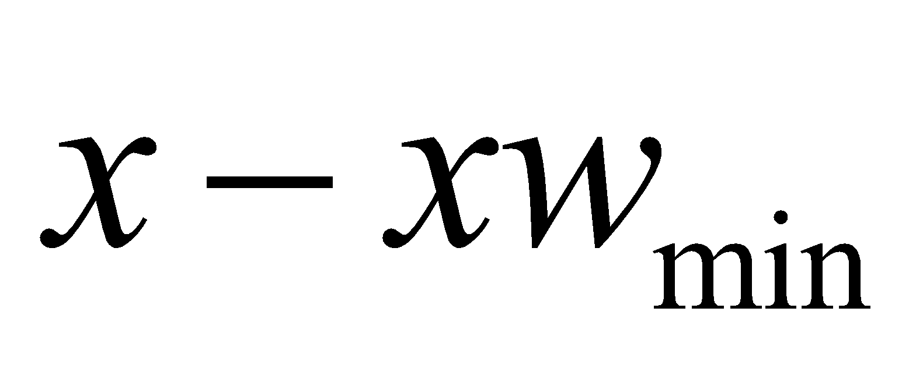
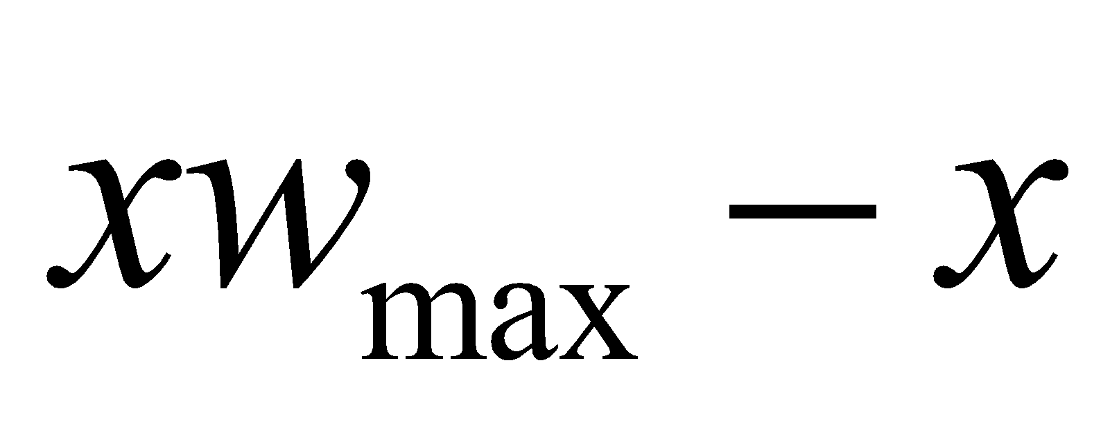
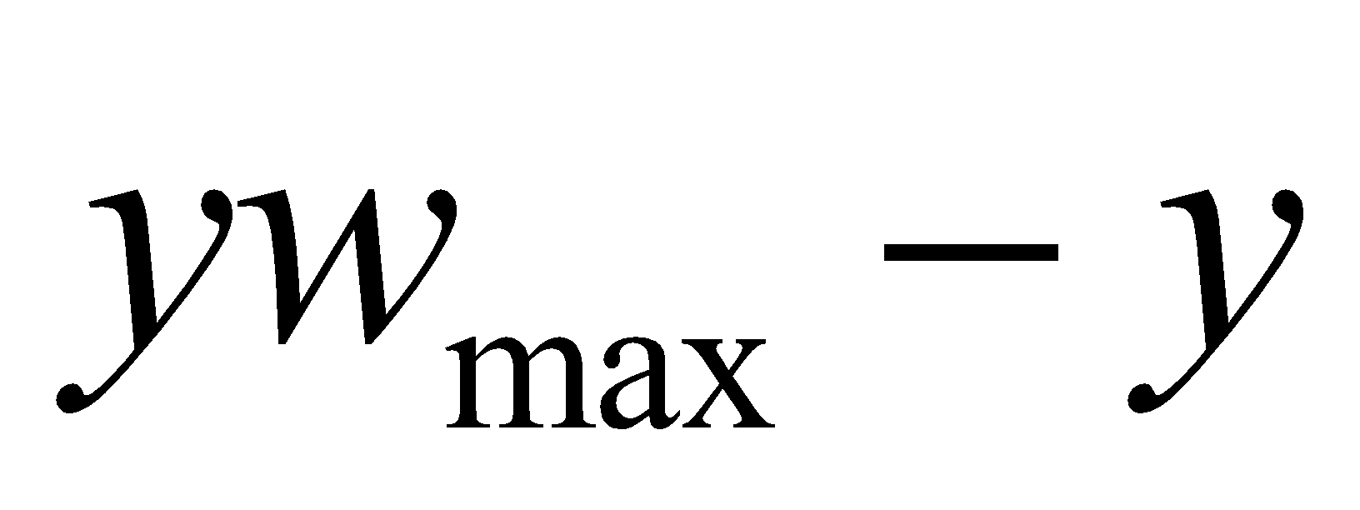
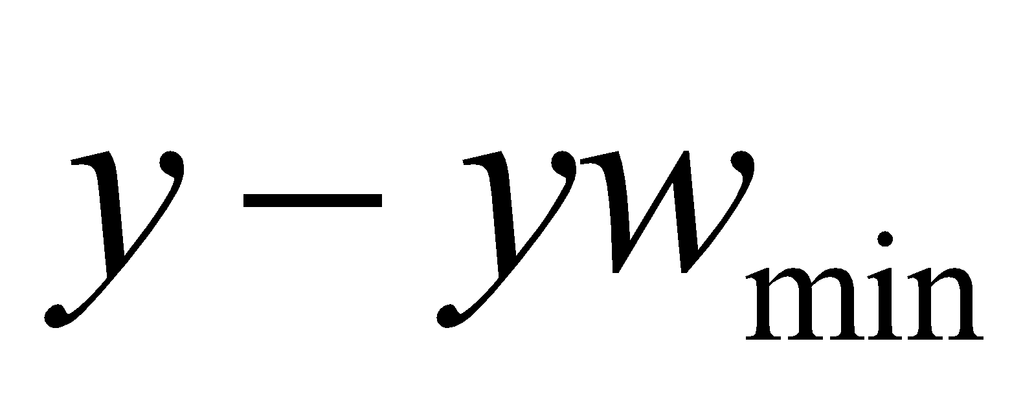
Region Codes
1
0
0
1
1
0
0
0
1
0
1
0
0
0
0
1
0
0
0
0
0
0
1
0
0
1
0
1
0
1
0
0
0
1
1
0

Slide 22
Cohen-Sutherland Line Clipping
Assign an outcode to each vertex of line
If both outcodes = 0, trivial accept
bitwise AND vertex outcodes together
If result ≠ 0, trivial reject
As those lines lie on one side of the boundary lines

Slide 23




Cohen-Sutherland Line Clipping
Trivial Acceptance: O(P0) = O(P1) = 0
1001
1000
1010
P1
0001
0000
0010
P0
0101
0100
0110
Notes:
‹#›

Slide 24

Cohen-Sutherland Line Clipping
Trivial Rejection: O(P0) & O(P1) ≠ 0
P0
1001
1000
1010
P1
P0
0001
0000
0010
P0
P1
P1
0101
0100
0110
Notes:
‹#›

Slide 25
Cohen-Sutherland Line Clipping
Compute the outcodes for the two vertices
Test for trivial acceptance or rejection
Select the first nonzero bit in the outcode to define the boundary against which the line segment will be clipped
Compute the intersection and replace the vertex with the intersection point
Compute the outcode for the new point and iterate
Notes:
‹#›

Slide 26
Example
A
1001
1000
1010
B
C
0001
0000
0010
0101
0100
0110
Notes:
‹#›

Slide 27
Example
1001
1000
1010
B
C
0001
0000
0010
0101
0100
0110
Notes:
‹#›

Slide 28
Example 2
1001
1000
1010
E
D
0001
0000
0010
C
B
A
0101
0100
0110
Notes:
‹#›

Slide 29
Example 2
1001
1000
1010
E
D
0001
0000
0010
C
B
0101
0100
0110
Notes:
‹#›

Slide 30
Example 2
1001
1000
1010
D
0001
0000
0010
C
B
0101
0100
0110
Notes:
‹#›

Slide 31
Example 2
1001
1000
1010
0001
0000
0010
C
B
0101
0100
0110
Notes:
‹#›

Slide 32
Cohen-Sutherland Examples
Consider the line P₉ to P₁₀ below
Start at P₁₀
Calculate the intersection of the line with the bottom boundary to generate point P₁₀’
The line P₉ to P₁₀’ is completely inside the window so is retained
Window
wy_{max}
P₉ [0000]
P₉ [0000]
wy_{min}
P₁₀’ [0000]
P₁₀ [0100]
wx_{min}
wx_{max}
Notes:
‹#›

Slide 33
Cohen-Sutherland Examples (cont…)
Consider the line P₃ to P₄ below
Start at P₄
Calculate the intersection point to generate P₄’
The line P₃ to P₄’ is completely outside the window so is clipped
P₄’ [1001]
P₄ [1000]
Window
wy_{max}
P₃ [0001]
P₃ [0001]
wy_{min}
wx_{min}
wx_{max}
Notes:
‹#›

Slide 34
Cohen-Sutherland Examples (cont…)
Consider the line P₇ to P₈ below
Start at P₇
From the two region codes of the two end-points we know the line crosses the left boundary so calculate the intersection point to generate P₇’
Window
wy_{max}
P₇’ [0000]
P₇ [0001]
P₈ [0010]
P₈’ [0000]
wy_{min}
wx_{min}
wx_{max}
Notes:
‹#›

Slide 35
Cohen-Sutherland Examples (cont…)
Consider the line P₇’ to P₈
Start at P₈
Calculate the intersection with the right boundary to generate P₈’
P₇’ to P₈’ is inside the window so is retained
Window
wy_{max}
P₇’ [0000]
P₇ [0001]
P₈ [0010]
P₈’ [0000]
wy_{min}
wx_{min}
wx_{max}
Notes:
‹#›

Slide 36
Thank You

